Slide 1
Sentimental analysis on marketing
Devolopment phase part-2

Slide 2
Course name: Artificial intelligence
Team name:Proj_227125_Team_1
Project name: Sentiment analysis on marketingProject
submitted to:Anna university / Nan mudhalvan
Year: lllDepartment:computer science and engineering
Semester:05
Group members: Mabika. R(212921104032)
Misba tharunam. S(212921104033)
Monica. T(212921104034)
Narmadha. D(212921104035)
Sandhiya. K(212921104042)
Sandhiya. S(212921104043)

Slide 3


Slide 4
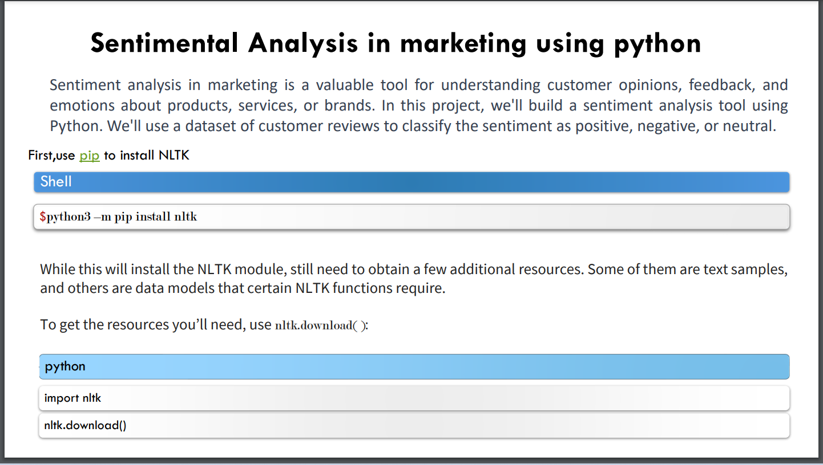

Slide 5
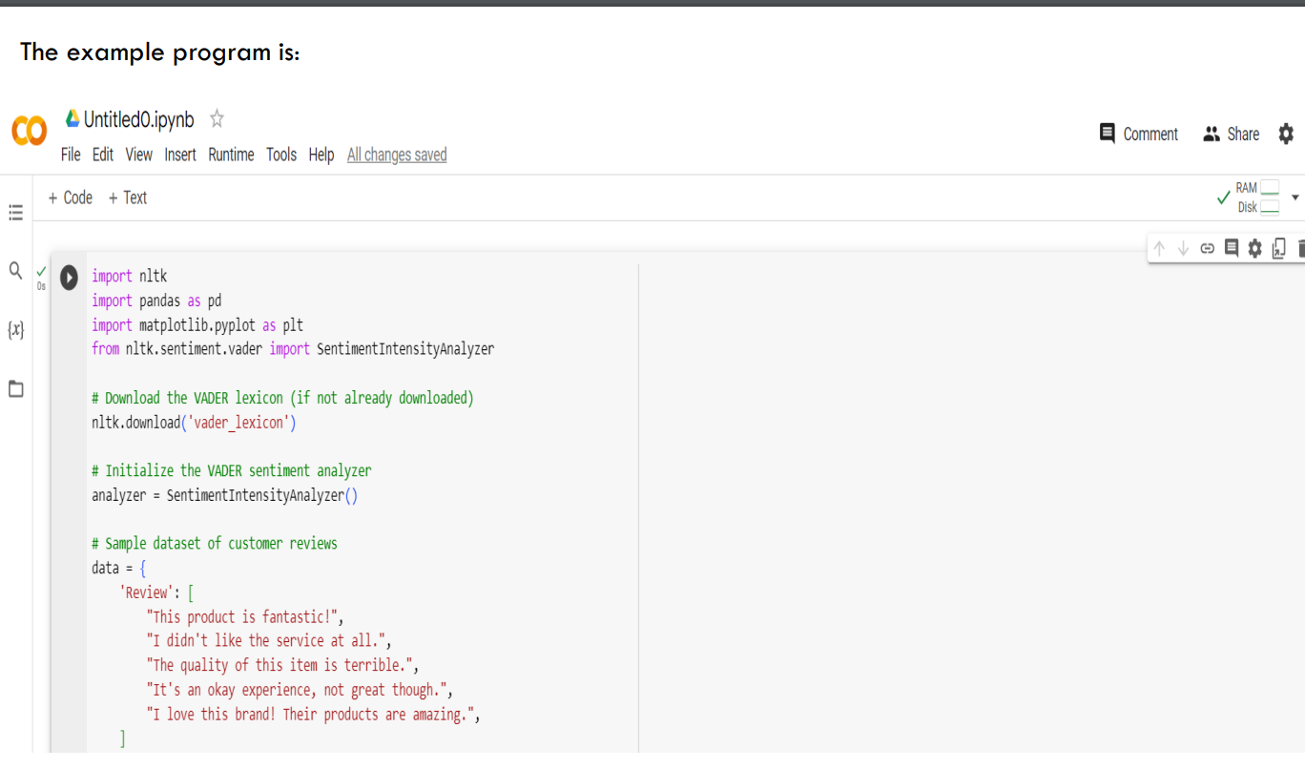

Slide 6
